Slide 1

01
02
File handling
Lecture p-1
04

Slide 2


Today’s Agenda
01
File Handling
02
Definition and where it is used today
03
How C++ supports file handling
04
Steps required to write data through file handling
05
Diagrams and Practical Implementation
05
05

Slide 3

File Handling
.
Write a program whose sample output are as follows:-
Sample Output
The numbers given
at execution time
cannot be used
once the code’s
execution is over
Select an option
1. Input 10 Numbers
2. Add Numbers
3. Display Result
4. Quit

Slide 4
File Handling
.
File handling in programming is a concept using which a programmer can save the data (values in variables, elements of the array and data members of an object) in the secondary memory of our computer so that it can be used upon next execution.
Some common examples of programs which use file handling are
mobiles contact book
mobiles contact logs
chatting application like WhatsApp
computer games etc.

Slide 5
How C++ supports file handling
.
C++ provides us 3 built-in classes to interact with files in our computer all these classes are available in the header file fstream and there names are as follows
ofstream:- This class allows us to create new files in our computer and write/save the data in them
ifstream:- This is opposite of ofstream class and it is used for opening existing file and reading there data
fstream:- This is a bidirectional class and can be used for both writing and reading operations in the file

Slide 6
Steps required for writing the data in the file
.
Steps | Code
create an object of the class "ofstream" | ofstream fout;
connect this object with a file on your hard-disk(pen drive) | fout.open("f:\\data.txt");
write the data | fout<<"Good Morning";
save and close the file | fout.close();

Slide 7
Task
.
Write a program to create a file called message.txt in e drive now ask the user to input a message and save it in the file

Slide 8
Solution
.
#include <fstream>
#include <iostream>
using namespace std;
int main()
{
ofstream fout;
fout.open(“E:\\c++ files\\message.txt");
char str[80], ch;
int i = 0;
cout<<"Type your message: ";
cin.getline(str, 80);
while(str[i] != '\0')
{
ch = str[i];
fout<<ch;
i++;
}
fout.close();
cout<<"File saved successfully!";
return 0;
}

Slide 9
Diagram-1
Console
Hard Disk
Type here message:
RAM
File(Actual File)
------------------------------
File(Image File)
-
fout
message.txt
Internal Read-Write Pointer
message.txt

Slide 10
Diagram-2
Console
Hard Disk
Type here message: Happy New Year
File(Actual File)
RAM
------------------------------
File(Image File)
Happy New Year
fout
message.txt
message.txt
Internal Read-Write Pointer

Slide 11
Diagram-3
Console
Hard Disk
Type here message: Happy New Year
File saved successfully!
Process returned 0 (0x0) execution time : 6.335 s
Press any key to continue.
File(Actual File)
RAM
Happy New Year
message.txt

Slide 12
Output of The Previous Code
Output
Type your message: Happy New Year
File saved successfully!
Process returned 0 (0x0) execution time : 6.335 s
Press any key to continue.

Slide 13
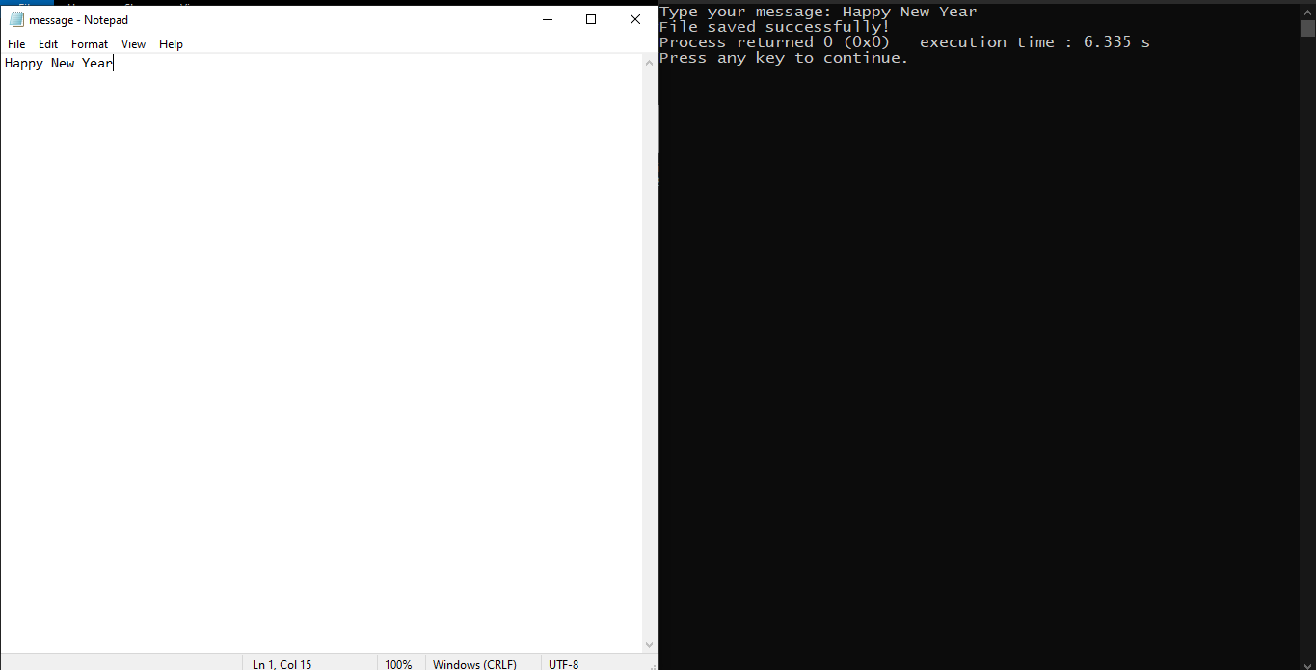
System Screenshot

Slide 14
Solution-2
.
#include <fstream>
#include <iostream>
#include <string>
using namespace std;
int main()
{
ofstream fout;
fout.open(“E:\\c++ files\\message.txt");
string text={};
cout<<"Type your message:";
getline(cin,text);
for(char ch:text)
{
fout<<ch;
}
fout.close();
cout<<"File saved successfully!";
return 0;
}

Slide 15
Task
.
Write a program which reads back the file message.txt and displays its
content on screen

Slide 16
Solution
.
#include <fstream>
#include <iostream>
using namespace std;
int main()
{
ifstream fin;
fin.open(“E:\\c++ files\\message.txt");
char ch;
while(1)
{
ch = fin.get();
if(fin.eof())
break;
cout<<ch;
}
fin.close();
cout<<endl<<"File read successfully!";
return 0;
}

Slide 17
Output of The Previous Code
Output
Happy New Year
File read successfully!
Process returned 0 (0x0) execution time : 0.154 s
Press any key to continue.

Slide 18
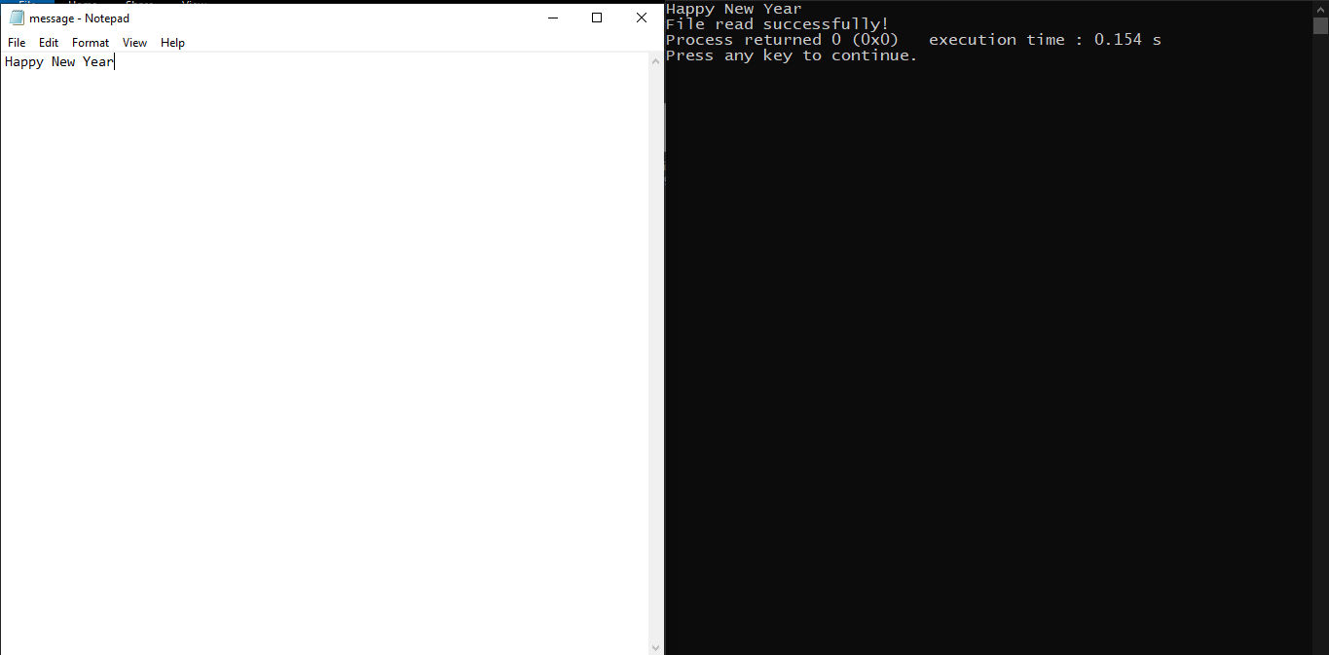
System Screenshot

Slide 19
Solution using extraction operator “>>”
.
#include <fstream>
#include <iostream>
using namespace std;
int main()
{
ifstream fin;
fin.open(“E:\\c++ files\\message.txt");
char ch;
while(1)
{
fin>>ch;
if(fin.eof())
break;
cout<<ch;
}
fin.close();
cout<<endl<<"File read successfully!";
return 0;
}

Slide 20
Output of The Previous Code
Output
HappyNewYear
File read successfully!
Process returned 0 (0x0) execution time : 0.115 s
Press any key to continue.

Slide 21
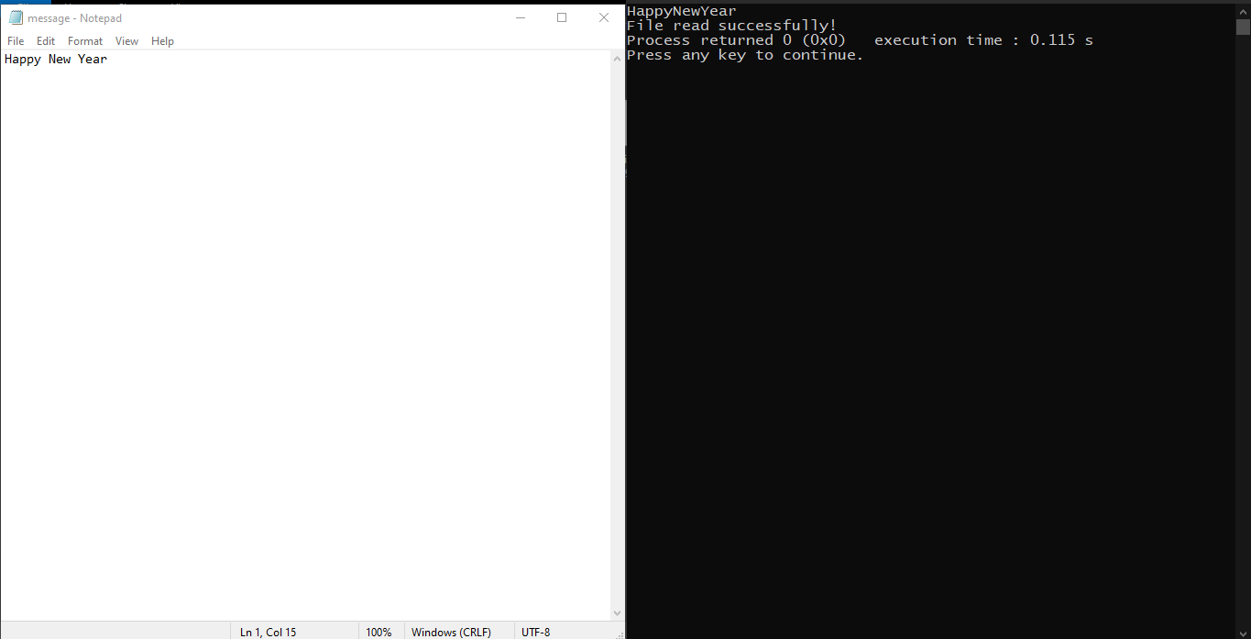
System Screenshot

Slide 22
Solution 1
.
#include <iostream>
#include <fstream>
#include <string>
#include "conio2.h"
using namespace std;
int main(){
fstream fobj;
fobj.open("E:\\c++ files\\message.txt");
string text;
cout<<"Type something:";
getline(cin,text);
for(char ch:text){
fobj<<ch;
}
cout<<endl<<"File saved successfully!"<<endl;;
getch();
char ch;
fobj.seekg(0);
while(1){
ch=fobj.get();
if(fobj.eof())
break;
cout<<ch;
}
fobj.close();
cout<<endl<<"File read successfully and closed!";
return 0;
}
pull back file pointer to beginning
open the file for writing as well as reading

Slide 23
Solution 2
.
#include <iostream>
#include <conio.h>
#include <fstream>
#include "conio2.h"
using namespace std;
int main()
{
fstream fobj;
fobj.open("E:\\c++ files\\message.txt");
char str[80], ch;
int i = 0;
cout<<"Type a message: ";
cin.getline(str, 80);
while(str[i] != '\0')
{
ch = str[i];
fobj<<ch;
i++;
}
cout<<"File saved successfully! Press any key to read it"<<endl;
getch();
fobj.seekg(0);
while(1)
{
ch = fobj.get();
if(fobj.eof())
break;
cout<<ch;
}
fobj.close();
cout<<endl<<"File read successfully!";
return 0;
}
open the file for writing as well as reading
pull back file pointer to beginning

Slide 24
Output of The Previous Code
Output
Type a message: Happy New Year
File saved successfully! Press any key to read it
Happy New Year
File read successfully!
Process returned 0 (0x0) execution time : 10.400 s
Press any key to continue.

Slide 25
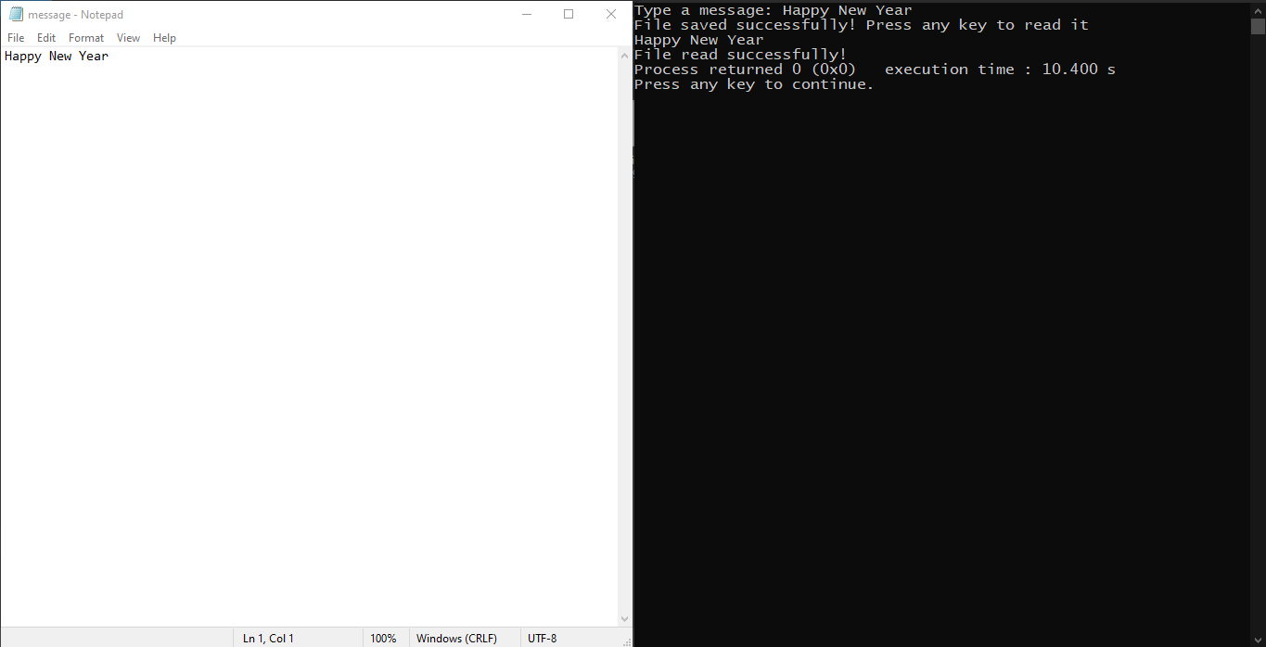
System Screenshot

Slide 26
Assignment 1
.
Write a program which accepts two file names from the user , opens
them and copies the contents of the first file to the second file. Finally
read and display the second file

Slide 27
Assignment 2
.
Write a program which accepts a file name from the user and display tototal number of upper case and lower case letters in the file

Slide 28
End of Lecture P-1
For any queries mail us @: scalive4u@gmail.com
Call us @ : 0755-4271659, 7879165533
Thank you

